Slide 1
Software Project Management
In the name of Allah, the Beneficent, the Merciful
Lecture 12:
Communication Management

Slide 2

It’s Story Time

Slide 3
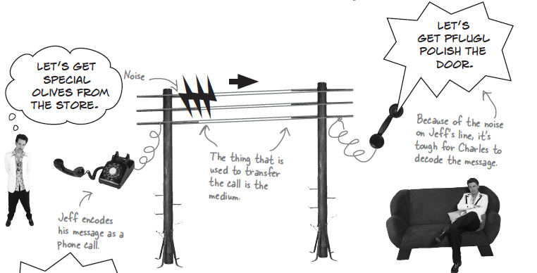

Slide 4
Project Manager’s Job?
Project Manager’s job is to ensure
that the work is done according to the project scope and within budget, while
also meeting project deadlines.

Slide 5
Project Manager’s Job?
Project Manager’s job is to ensure
that the work is done according to the project scope and within budget, while
also meeting project deadlines.

Slide 6
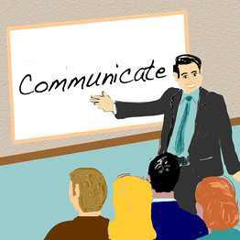
Communication is Important:
Why?
It consumes 90% of
a Project Manager’s
time.

Slide 7
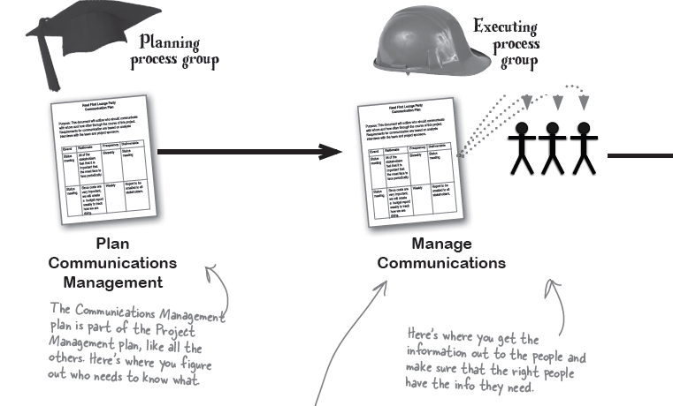
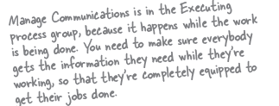

Slide 8
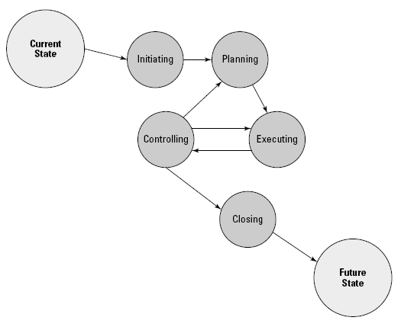
The Big Picture: Process Groups

Slide 9
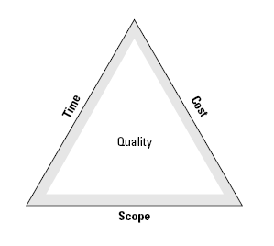
Importance of Communicating Effectively
Clear and accurate communication within your project team is vital to project success.

Slide 10
Importance of Communicating Effectively
Poor communication costs time and money
Communication planning is all about deciding who should get which information, when, and who should send it, in what format and by which channel

Slide 11
Can Everyone Communicate Effectively?
?

Slide 12
Can Everyone Communicate Effectively?
NO

Slide 13
Ensuring Accurate Communication
Everyone, from members of the project team to project stakeholders, must communicate openly and accurately.
Facilitate each conversation with a mission to understand exactly what the person speaking is trying to convey,

Slide 14
Information sensitivity:
important area for project manager to consider while making the communication plan
Critical information such as financials and contractual data is not for consumption by everyone, and can create issues or pose risks for project success if reaches wrong stakeholders

Slide 15
Ensuring Accurate Communication
Document your conversations
Sign where the line is dotted
Scope statement
Scope changes
Budget
Schedule
Document scope, time, or cost compromises
Take minutes
Set an agenda

Slide 16
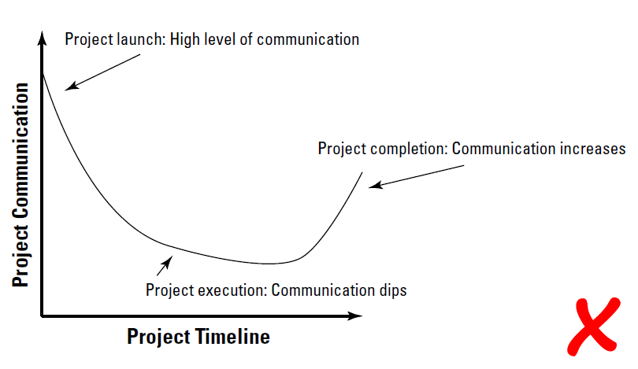
Communication / Project Timeline

Slide 17
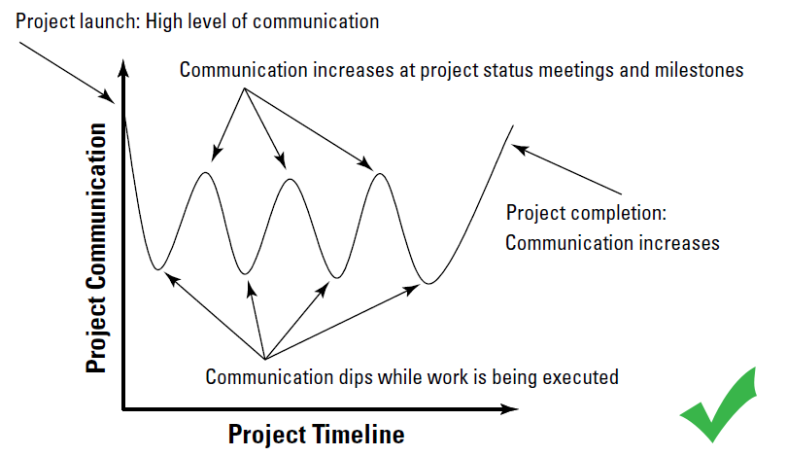
Communication / Project Timeline

Slide 18
Communication Management Plan
Communication Management Plan documents all of the communication demands within the project.
plan that defines how and when communication should occur

Slide 19
Communication Management Plan
Communication Documents reports, e-mails, or scheduled meetings
Purpose brief explanation of the document’s or meeting’s purpose
Frequency how often communication is needed
Modality format for the communication pieces
Duration defines how long, and when, the stakeholders will need to participate in project communications
Responsibility people need to communicate with one another - not to you

Slide 20
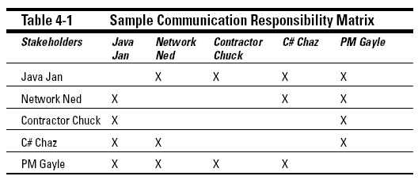
Communication Responsibility Matrix
NOTE: When you create the WBS, you have an ideal opportunity to also document which stakeholders need to talk to whom.

Slide 21
Communication Modalities
Modalities for Formal Communication Presentations, Reports, Conference/phone calls, Email
Modalities for Informal Communication Email, Ad-hoc meetings, Instant messaging and text messaging, Coffee talk

Slide 22
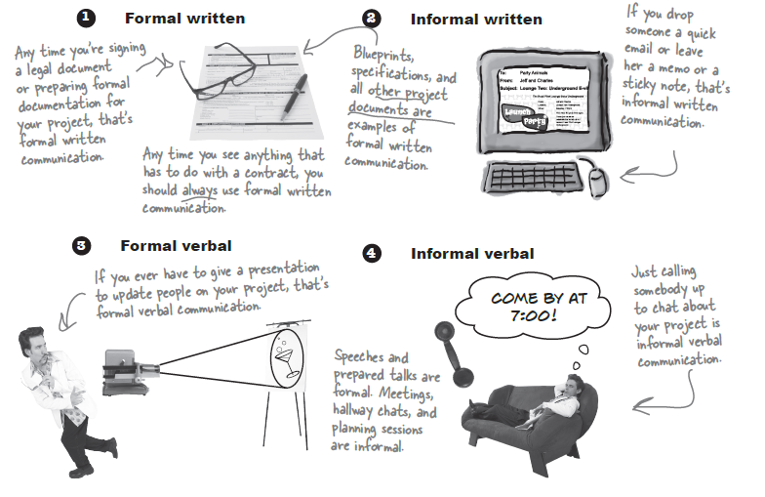

Slide 23
Set An Agenda
Before you schedule a meeting as a facilitator or as a participant, determine the meeting’s purpose and then prepare accordingly
Purpose of the meeting
Scheduled start and finish time, as well as the location of the meeting
Participants of the meeting
Items to be discussed in the meeting
Review of action items

Slide 24
Analyzing Communications Requirements:
The main goal would be to figure out who should be given what information and when
People should not be overwhelmed with amount and frequency of information coming their way.
In the clutter of information people may miss important information they really need

Slide 25
Communication Channels:
You may not use all of them, but you can use this information to ensure that the communication plan does not leave out any of the stakeholders
N(N-1) / 2
N = Number of Key Stakeholders
For Example: If N=10
Communication Channels = 10(10-1)/2
= 90/2
= 45
NOTE: If N=2, Number of Communication Channel is 1

Slide 26
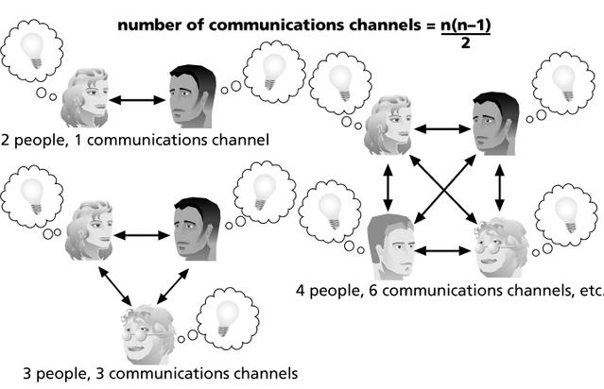
Communication Channel:

Slide 27
Q & A

